Slide 1
Update on the Industrial Storm Water Program and Implementation of the Renewed General Permit
Item No. 7
May 18, 2017
Santa Rosa, California
Mona Dougherty, P.E.
North Coast Regional Water Quality Control Board

Slide 2
Presentation Outline
Industrial storm water program overview
Significant changes in the renewed permit
Review of the 2015-2016 annual reports
Example of BMPs at North Coast facilities
Successes and challenges
Current and future priorities

Slide 3
Storm Water Program
Point source national pollutant discharge elimination system - NPDES
Industrial, construction, and municipal
North Coast Region
Industrial: Paul Keiran
Municipal: Colleen Hunt
Construction: Devon Jorgenson
Scientific Aide: Shawn Agarwal
Program manager: Mona Dougherty

Slide 4
Industrial Storm Water Overview
Make, move, mine products
Program based on best management practices (BMPs)
No numeric effluent limits
BMPs should be as simple and as low maintenance as is effective
Pollutants: sediment, metals, hydrocarbons, pollutants that effect pH

Slide 5
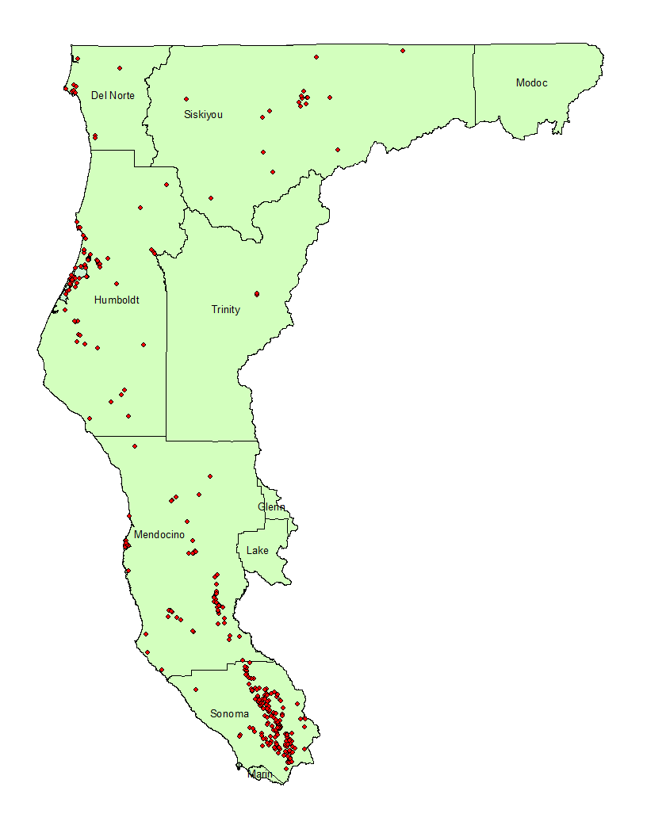
North Coast Industrial Facilities
Created by Shawn Agarwal
May 12, 2017

Slide 6
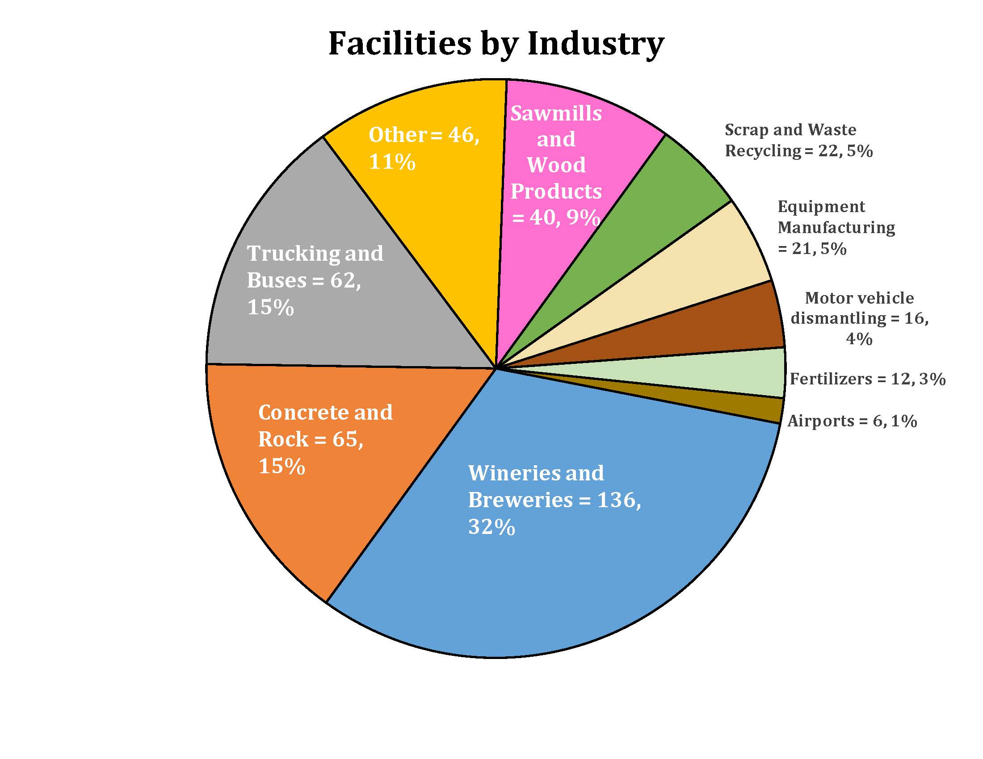

Slide 7
Industrial Storm Water Overview
Types of facilities not included:
Kennels, boarding, and veterinarians
Nurseries, landscaping stores, farm supply stores, home improvement stores, winery pomace and agriculture composting operations
Auto repair, auto dealerships
Industries on tribal lands – USEPA permit

Slide 8
Industrial Storm Water General Permit (IGP) Overview
1987 - Clean Water Act amended to include industrial and municipal storm water
1991 and 1997 – Previous versions of IGP adopted
2014 - Reissued IGP adopted
July 1, 2015 - Reissued IGP became effective

Slide 9
Industrial Storm Water General Permit (IGP) Overview
IGP adopted by State Water Board
IGP requires monitoring and annual reporting
Pollutants compared to benchmark levels from USEPA’s 2008 Multi-Sector General Permit for storm water discharges
Best available technology economically achievable (BAT)/best conventional pollutant control technology (BCT)

Slide 10
Reissued Industrial Storm Water General Permit and Significant Changes from the Previous Permit

Slide 11
Significant Changes
No Exposure Certification (NEC)
Notice of non-applicability (NONA)
Additional sampling: four qualifying storm events, all discharge points
Visual monitoring: all discharge points, industrial activities and storage areas

Slide 12
Significant Changes
U.S.EPA Benchmark Levels are now Numeric Action Levels (NALs)
Exceedances require:
Exceedance Response Action Report
Additional BMPs to avoid future exceedances
Qualified Industrial Storm Water Practitioner (QISP)

Slide 13
Significant Changes
Three levels of regulation
Baseline: Permittees start here
Level 1, exceedance of NAL(s): ERA report, additional BMPs, QISP
Level 2, exceedance of NAL(s) next year: More robust report, additional BMPs

Slide 14
Significant Changes
Electronic reporting required: statewide database (SMARTS)
Clean Water Act 303(d) List evaluation
Design standards for treatment control BMPs
Requirements for discharges to Areas of Special Biological Significance

Slide 15
Review of 2015-2016 Reporting Year
First annual report submitted under the new IGP

Slide 16
Review of 2015-2016 Reporting Year
Approximately 450 active facilities in North Coast Region
84 facilities have received NEC
7 facilities have received NONA

Slide 17
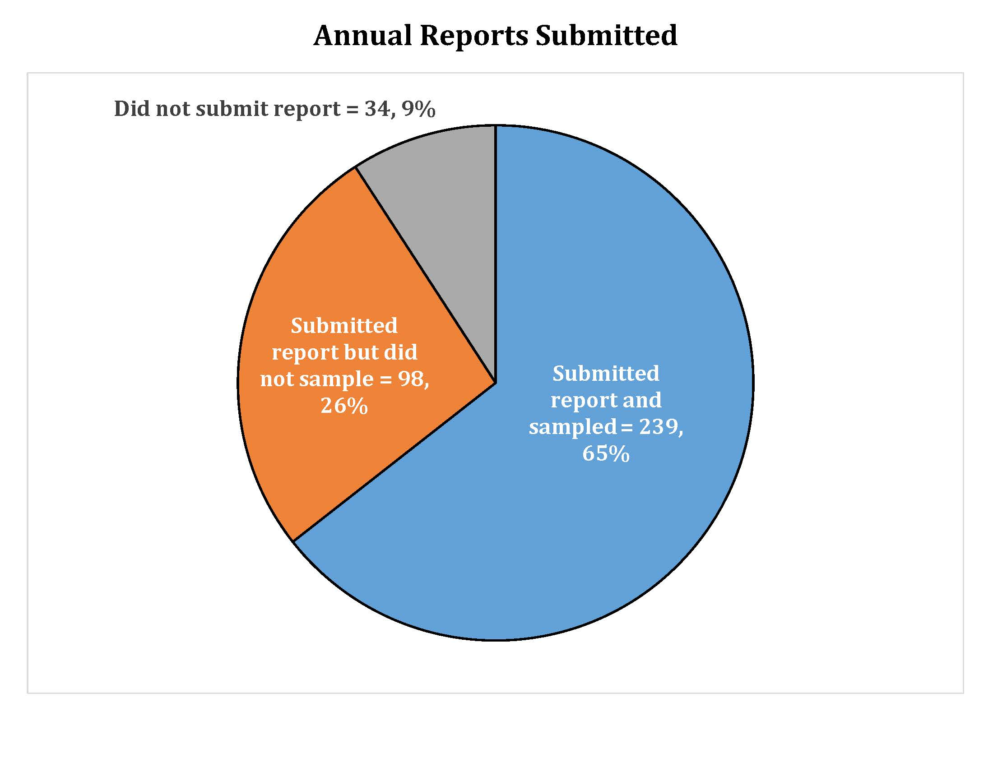

Slide 18
Review of 2015-2016 Reporting Year
98 facilities submitted an annual report, did not sample
Burden to prove discharge lies with Regional Board staff
Statewide issue – benefits of non-compliance
Prevents us from assessing permit compliance and potential threats to water quality

Slide 19
Review of 2015-2016 Reporting Year
65 facilities were moved from baseline to level 1
Most common exceedances: total suspended solids (TSS), iron, and aluminum
Exceedance response action (ERA) reports were due January 1, 2017
64 facilities have submitted the ERA report

Slide 20
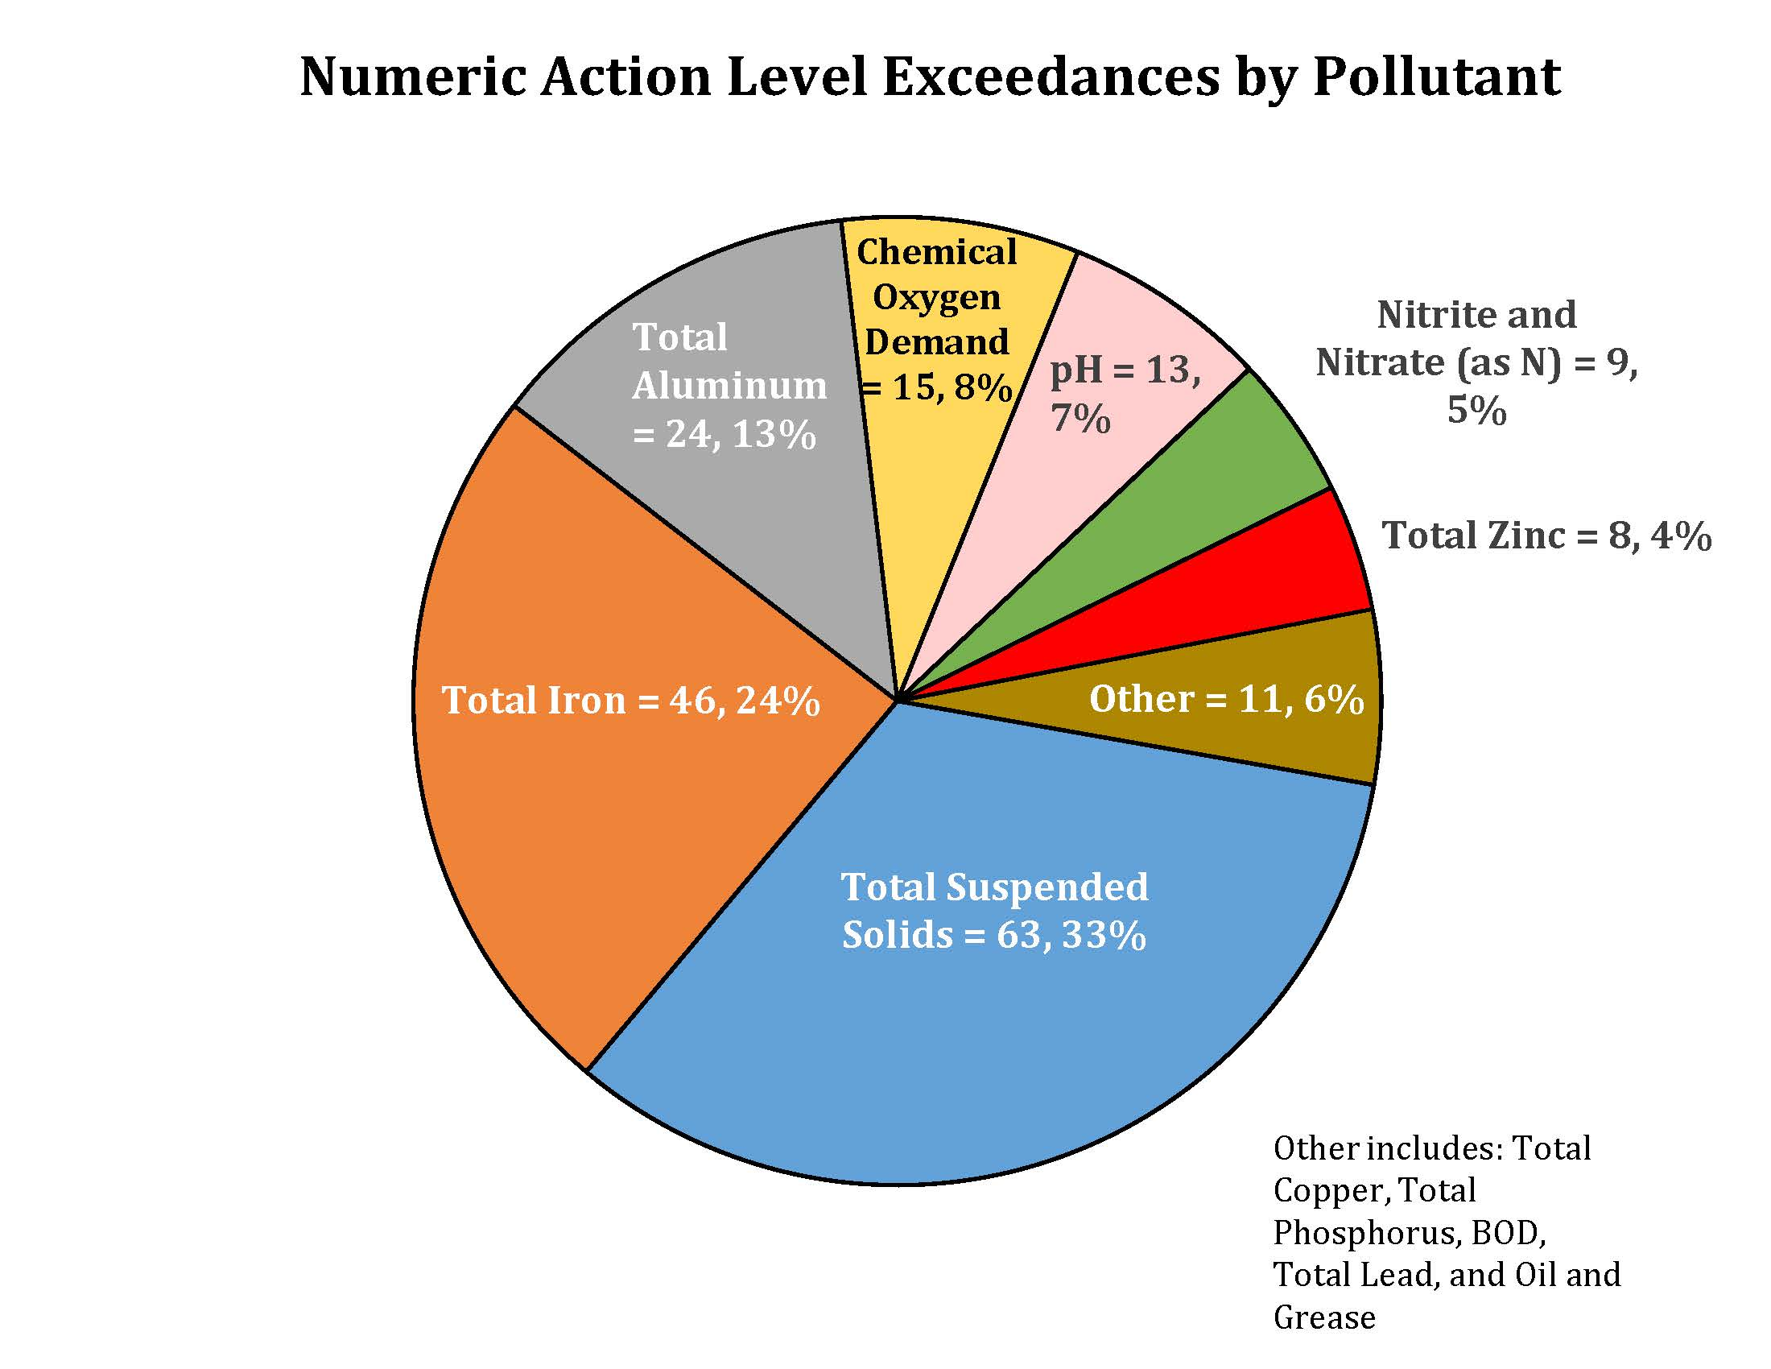

Slide 21
Industrial Storm Water General Permit Implementation Improved BMPs at North Coast Industrial Facilities

Slide 22
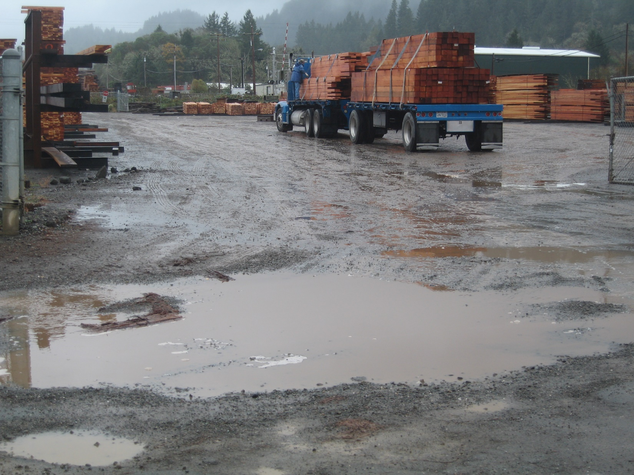
Packed gravel lumber storage yard at sawmill

Slide 23
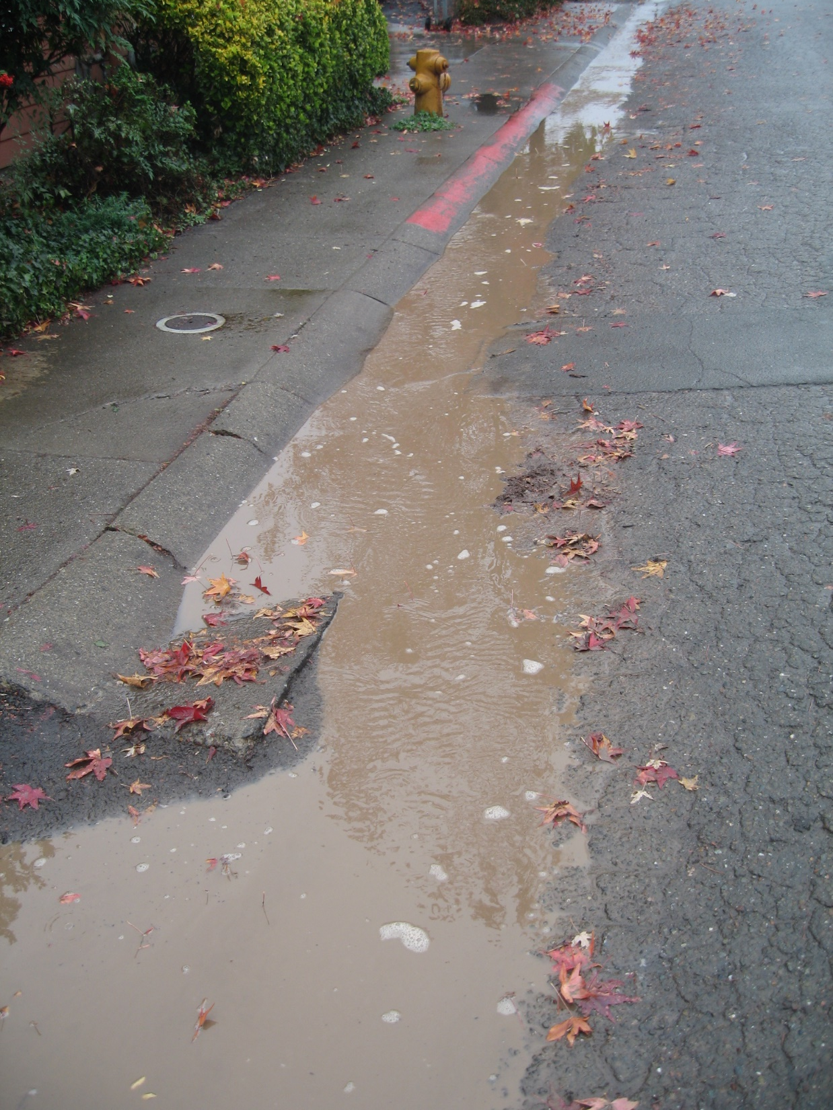
Resulting turbid storm water discharge

Slide 24
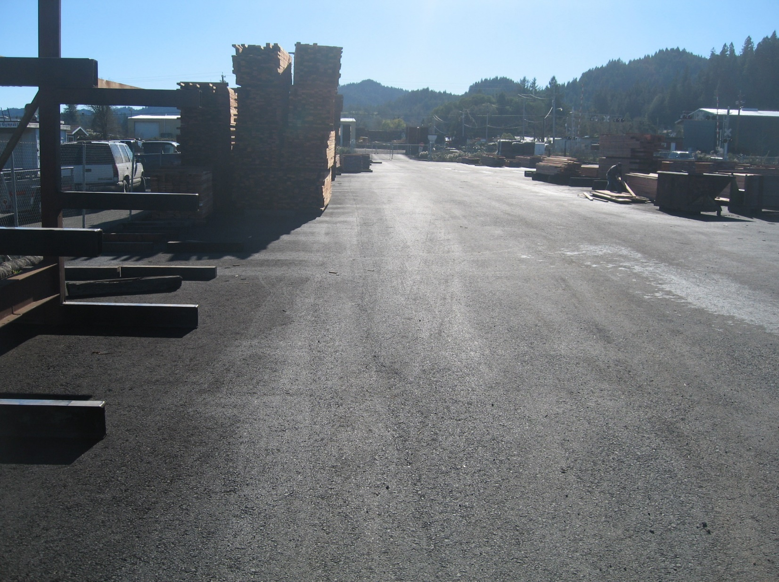
Paved the following year

Slide 25
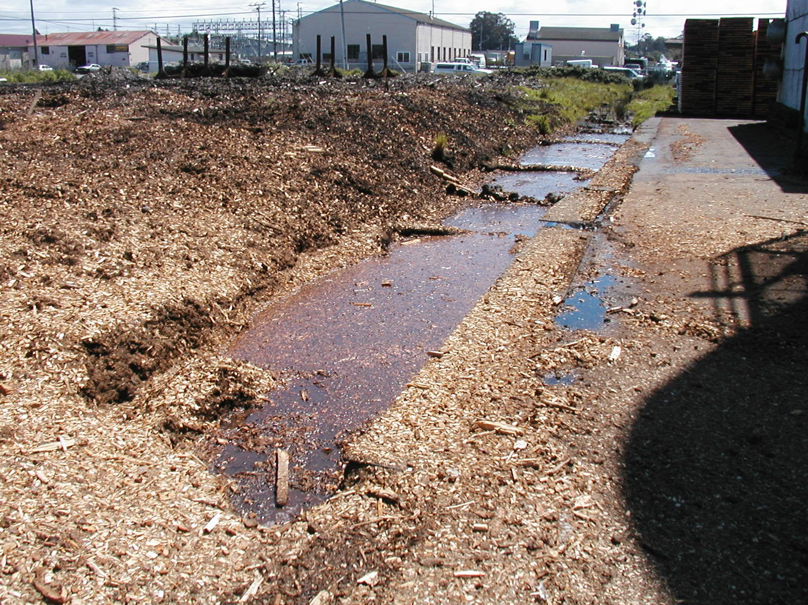
North Coast sawmill – Chemical Oxygen Demand

Slide 26
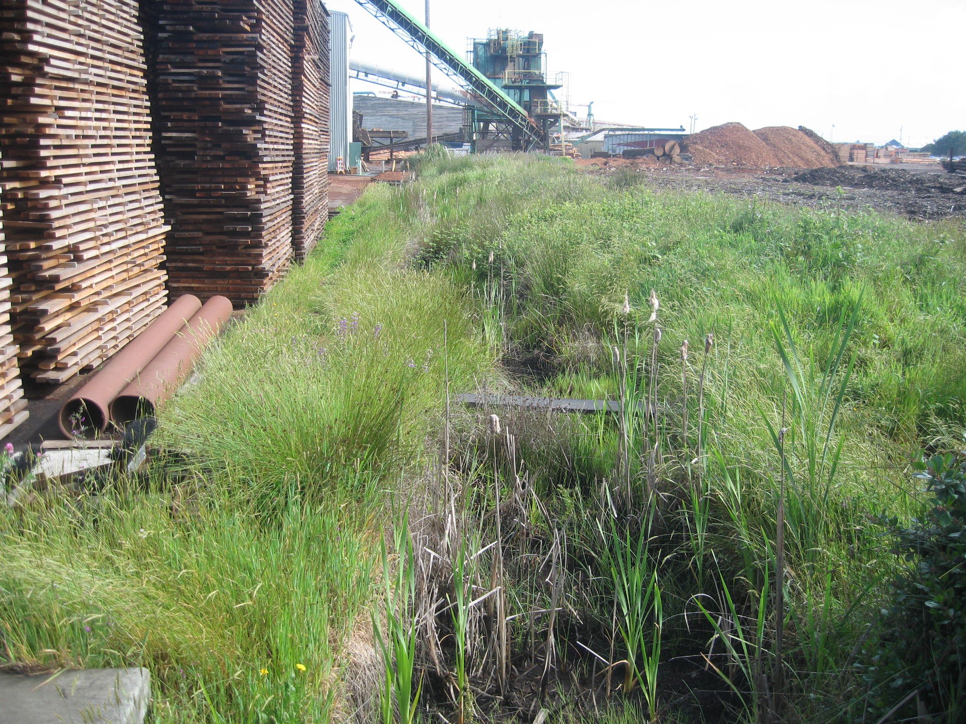
Same channel two years later

Slide 27
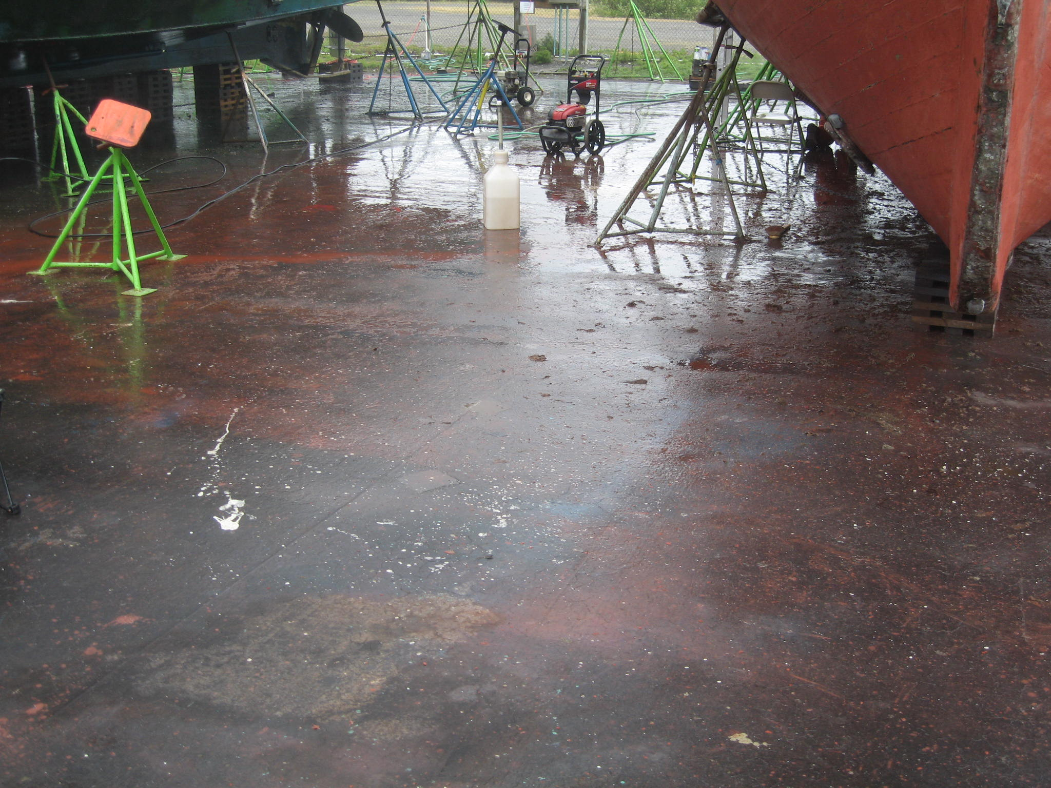
Boat repainting facility with direct discharge to Humboldt Bay

Slide 28
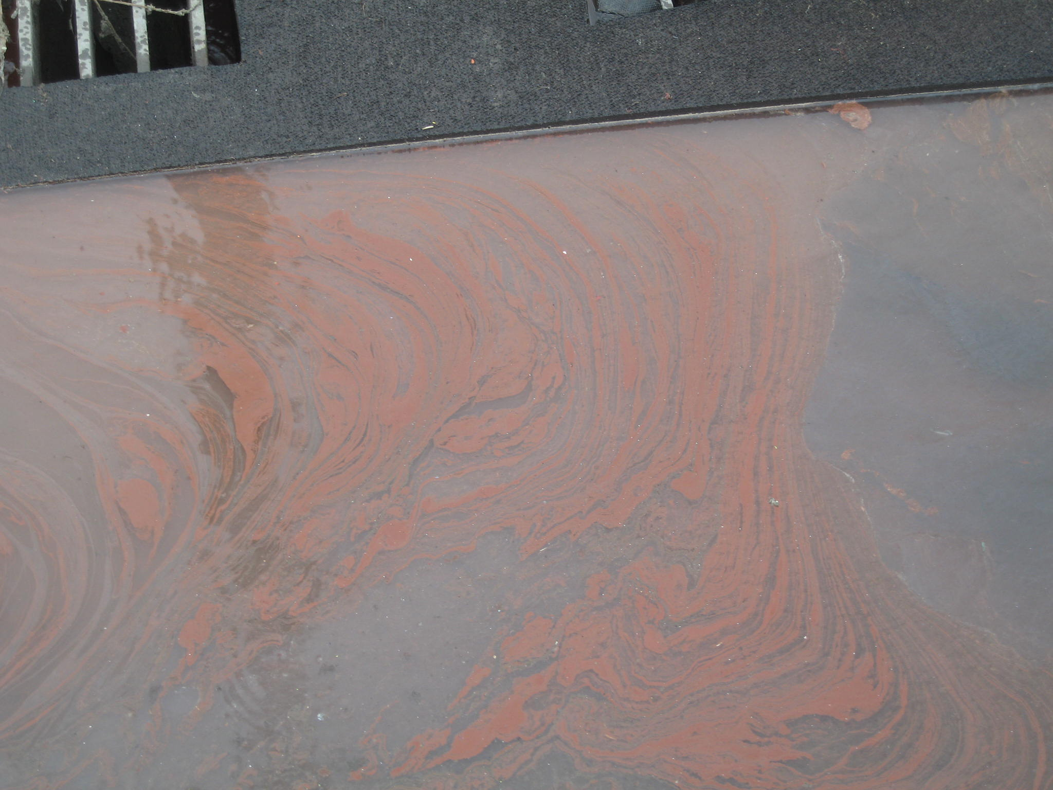
Dissolved and total metals discharged directly to bay

Slide 29
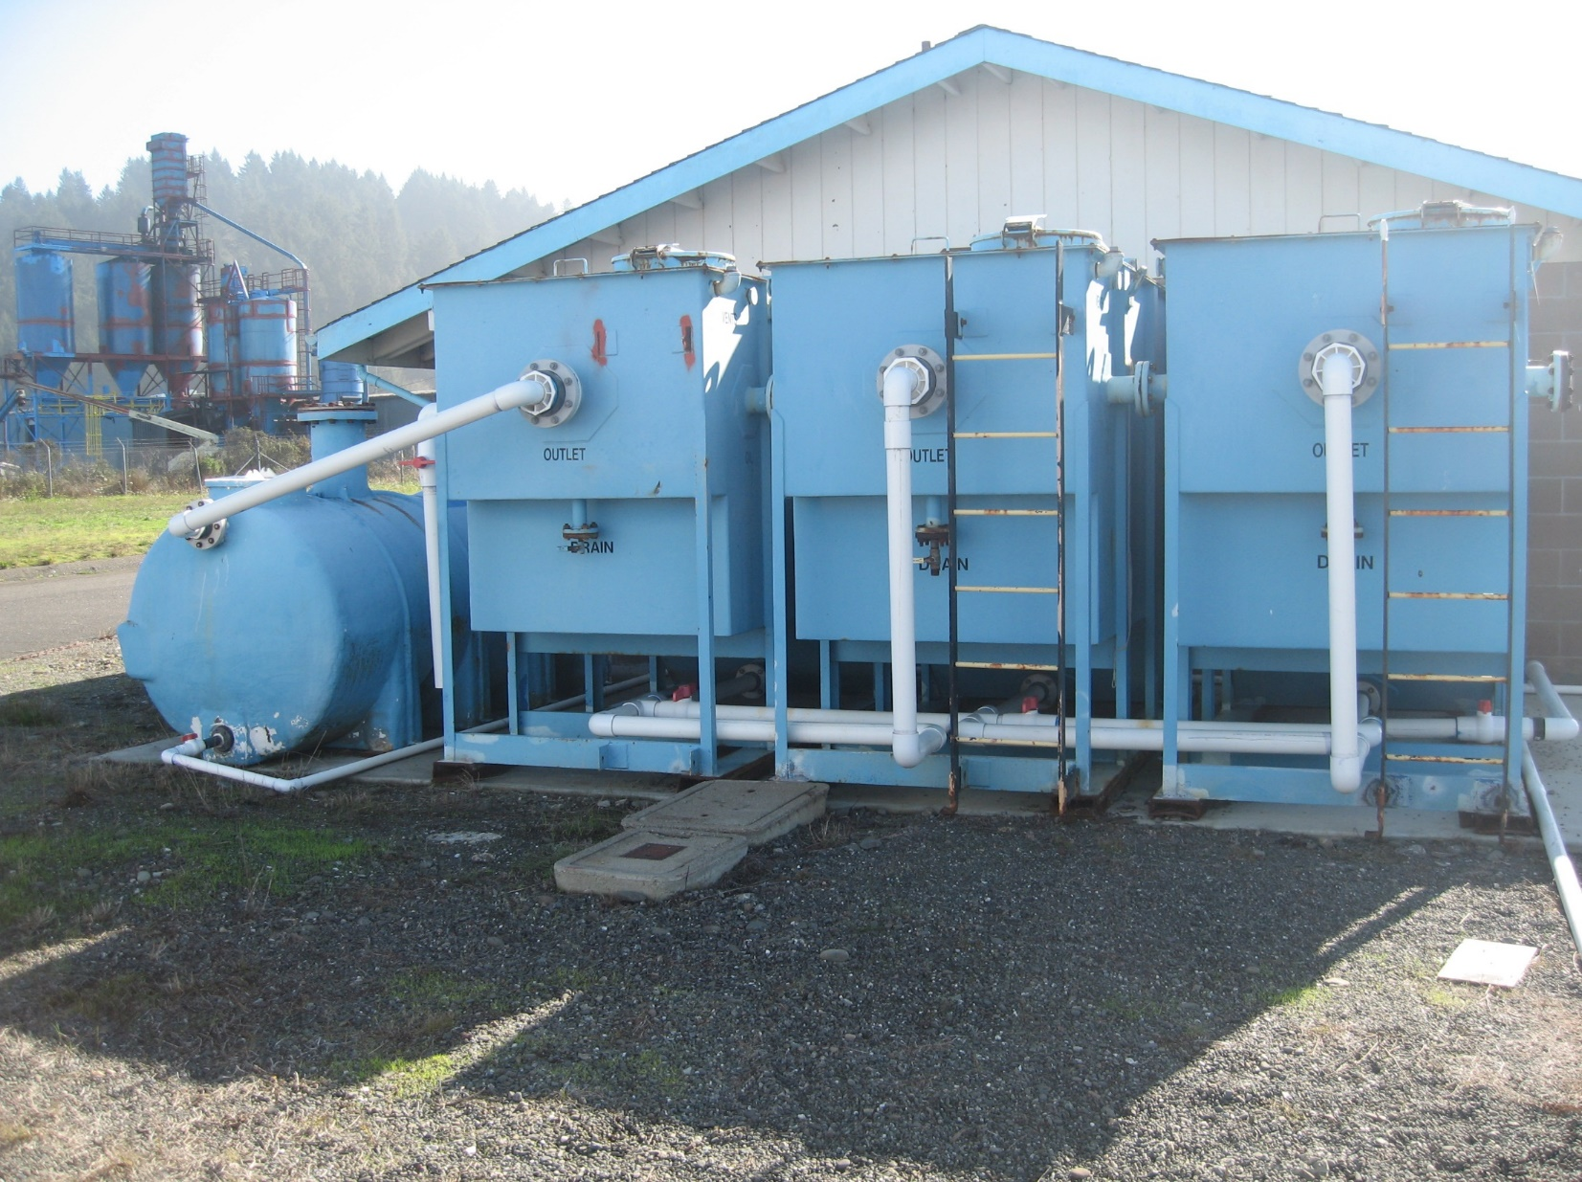
Advanced multi-stage treatment system

Slide 30
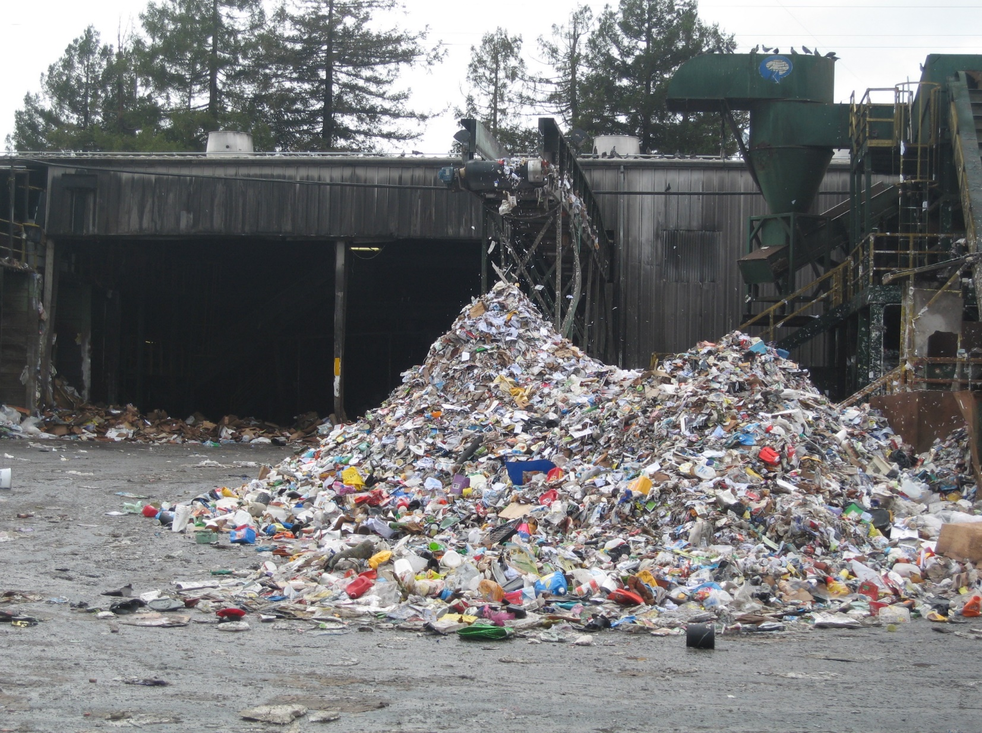
Exposed pile at recycling center – Biochemical Oxygen Demand (BOD), Total Suspended Solids (TSS)

Slide 31
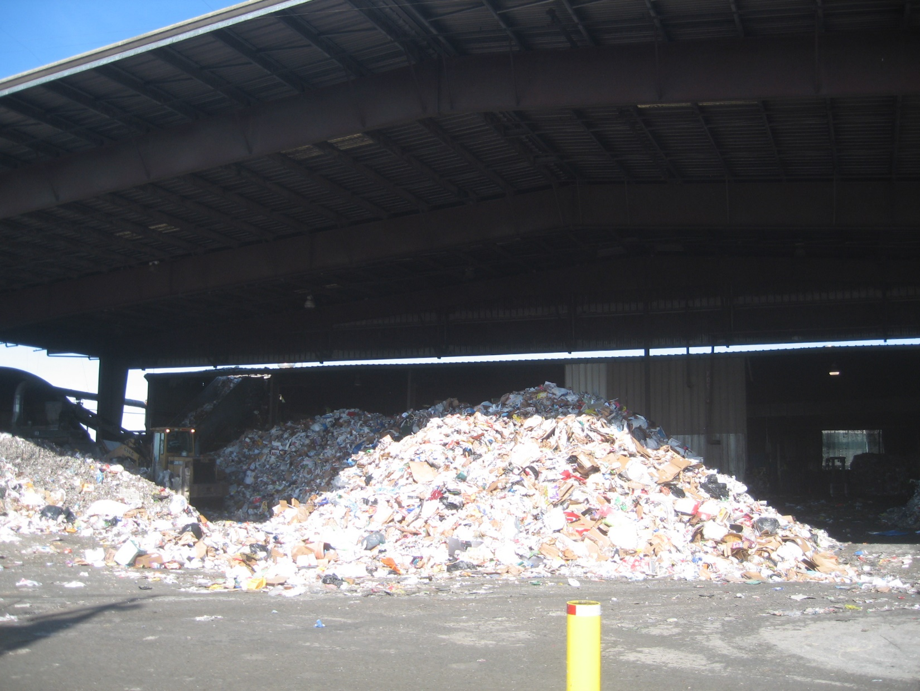
Canopy cover constructed

Slide 32
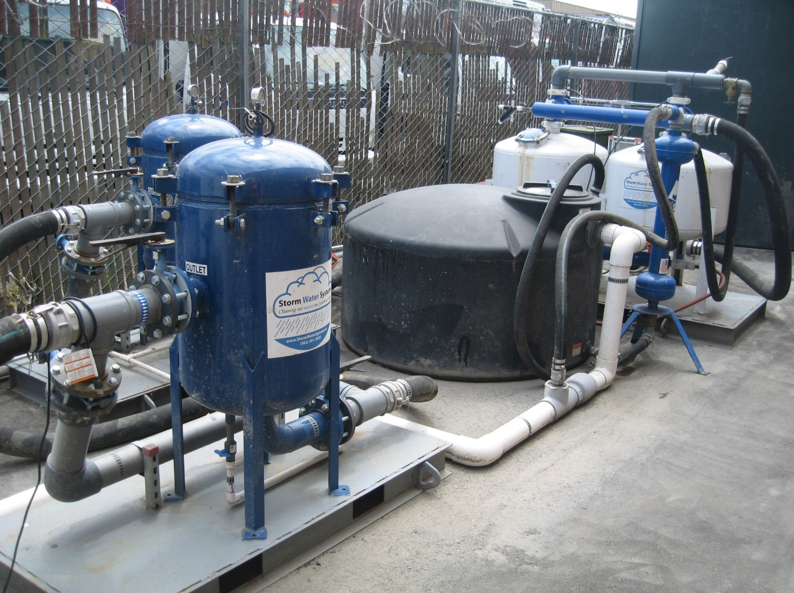
Sand, paper, carbon filtration system

Slide 33
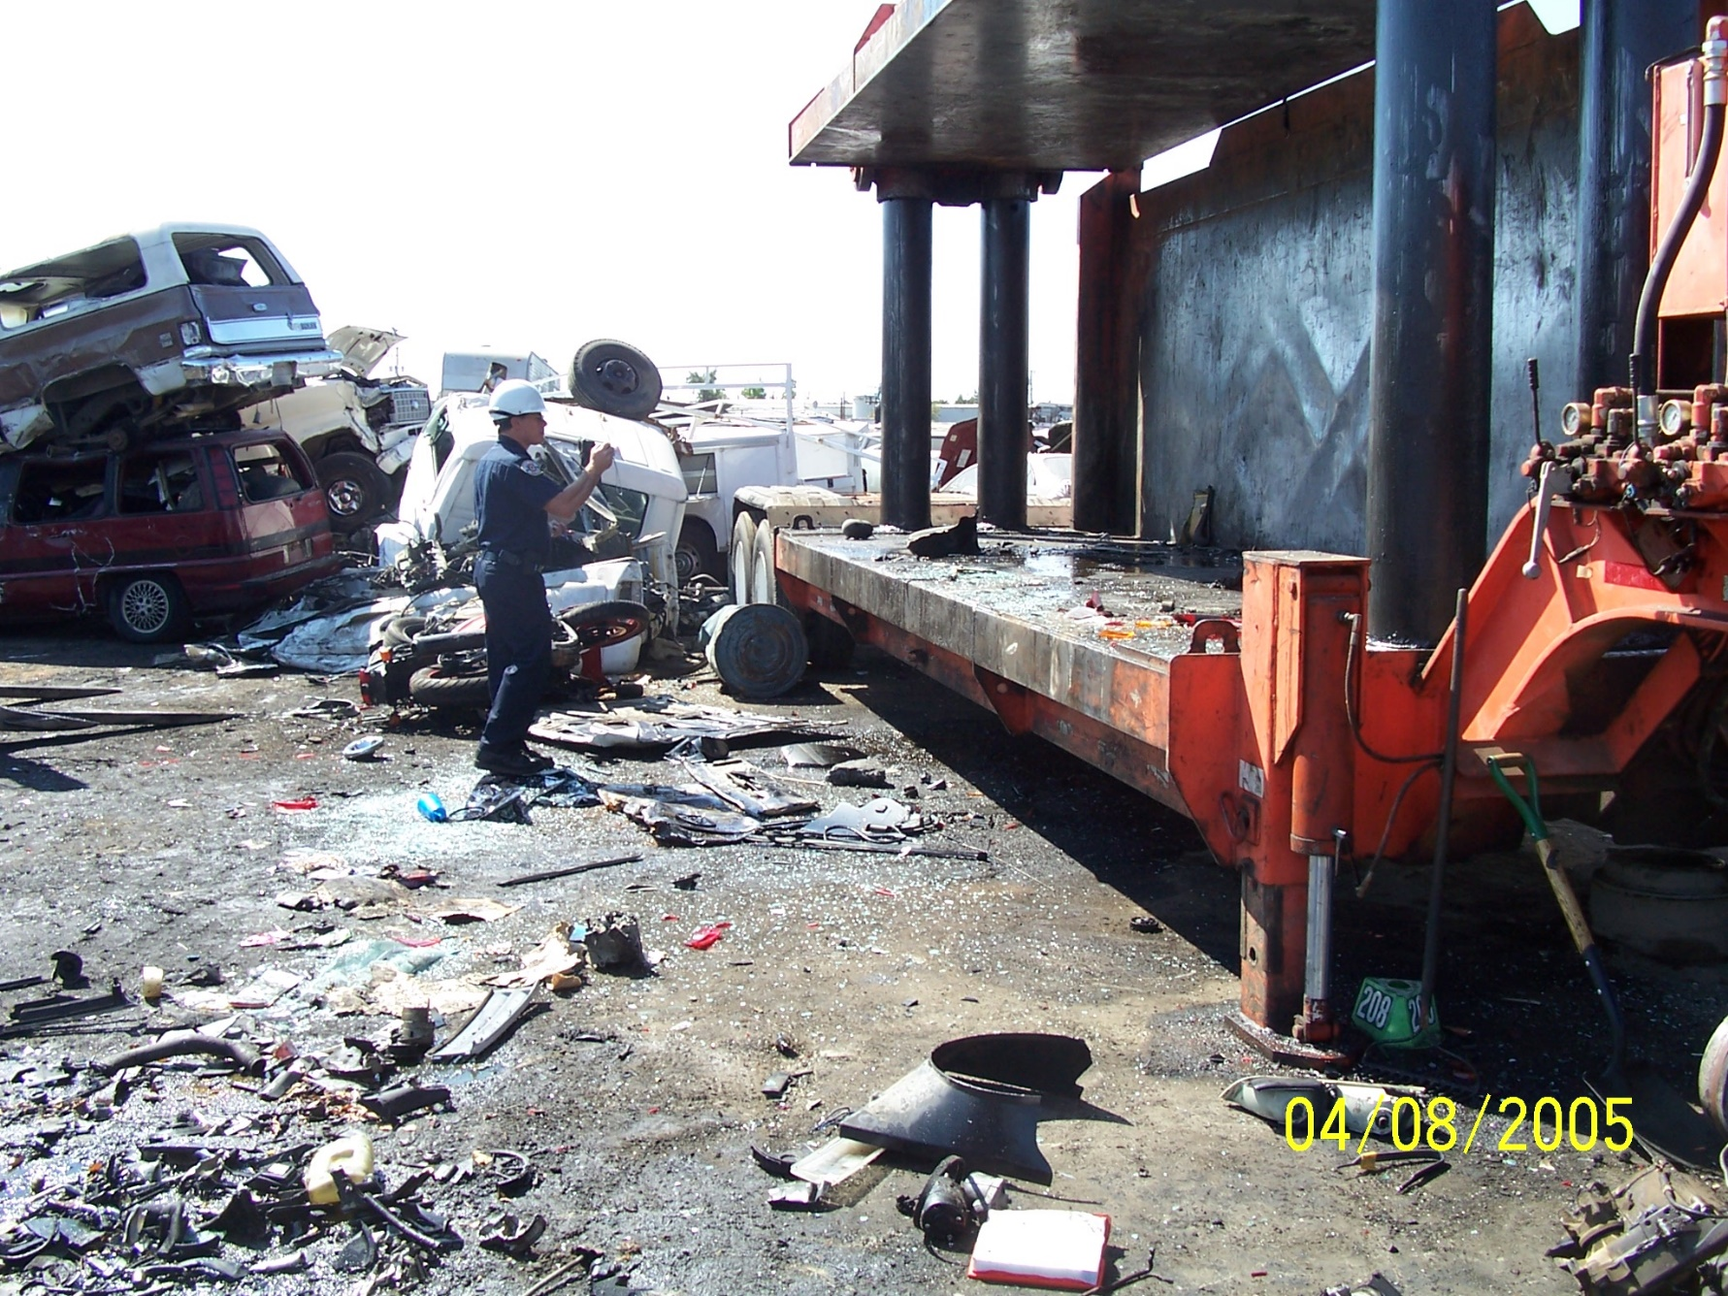
Auto wrecking yard

Slide 34
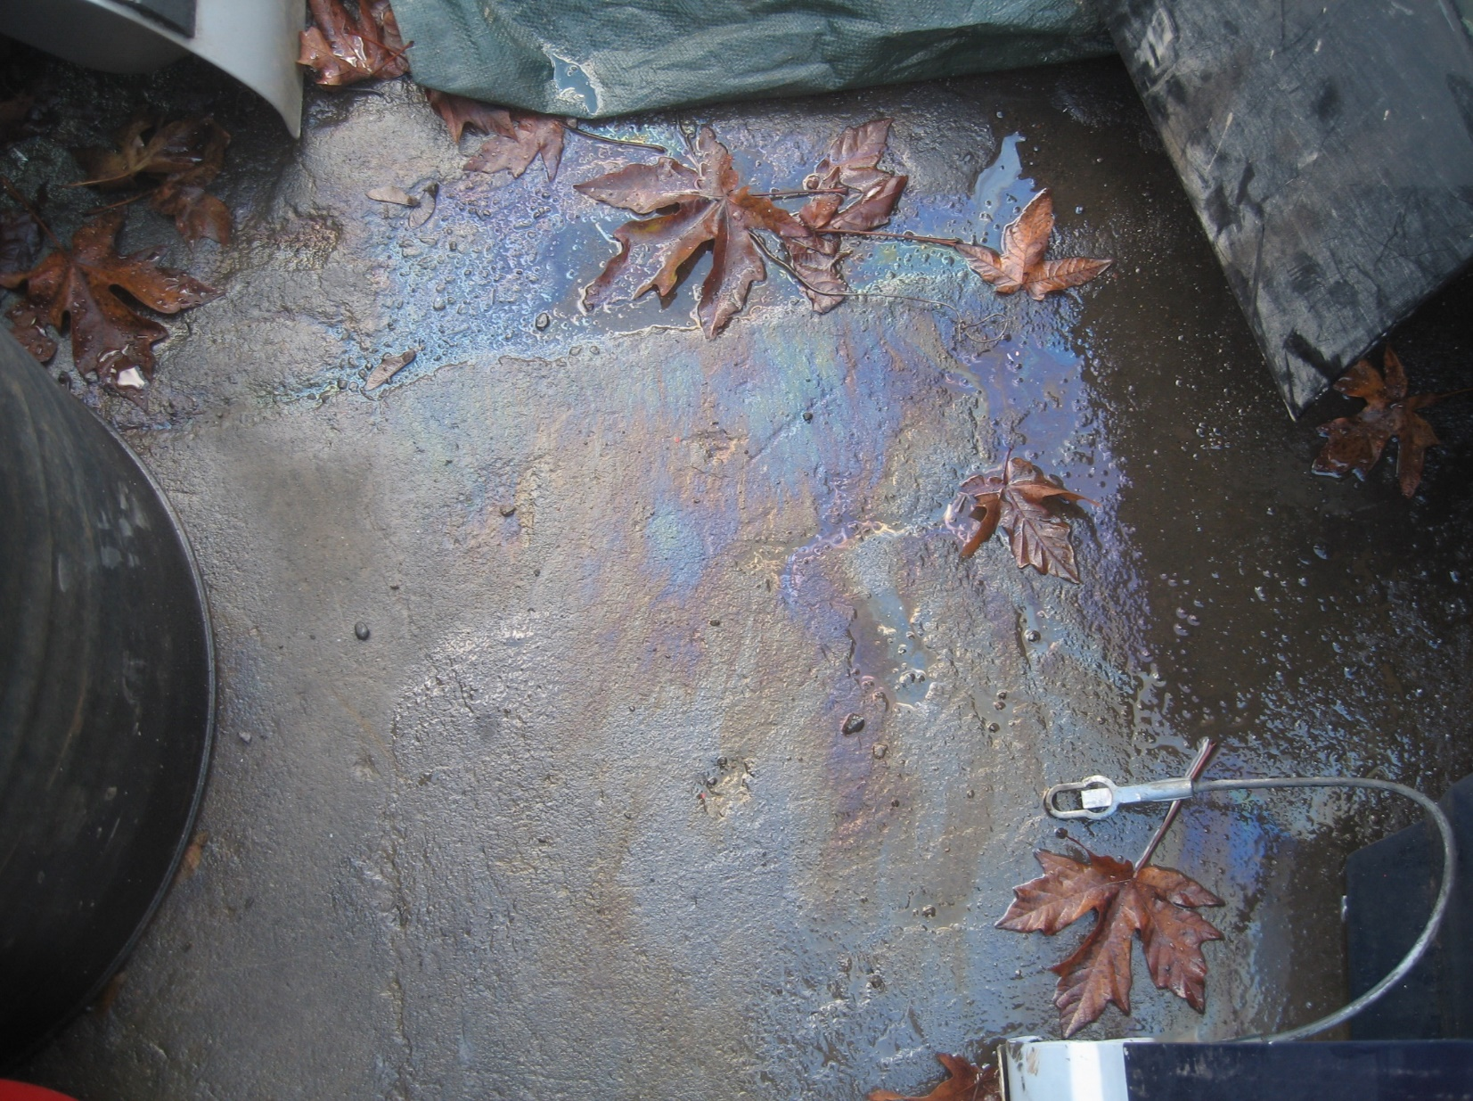
Hydrocarbons and heavy metals

Slide 35
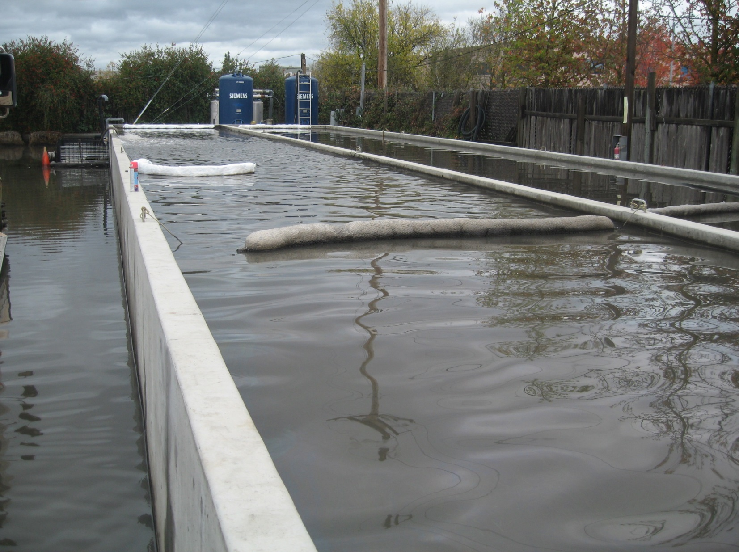
25,000 gallon holding tank and multi-stage treatment

Slide 36
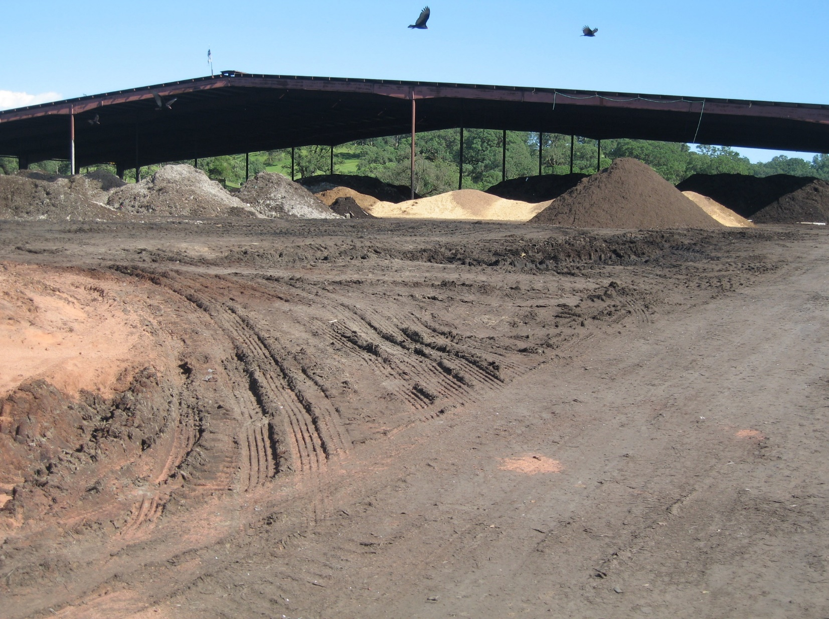
Large composting operation

Slide 37
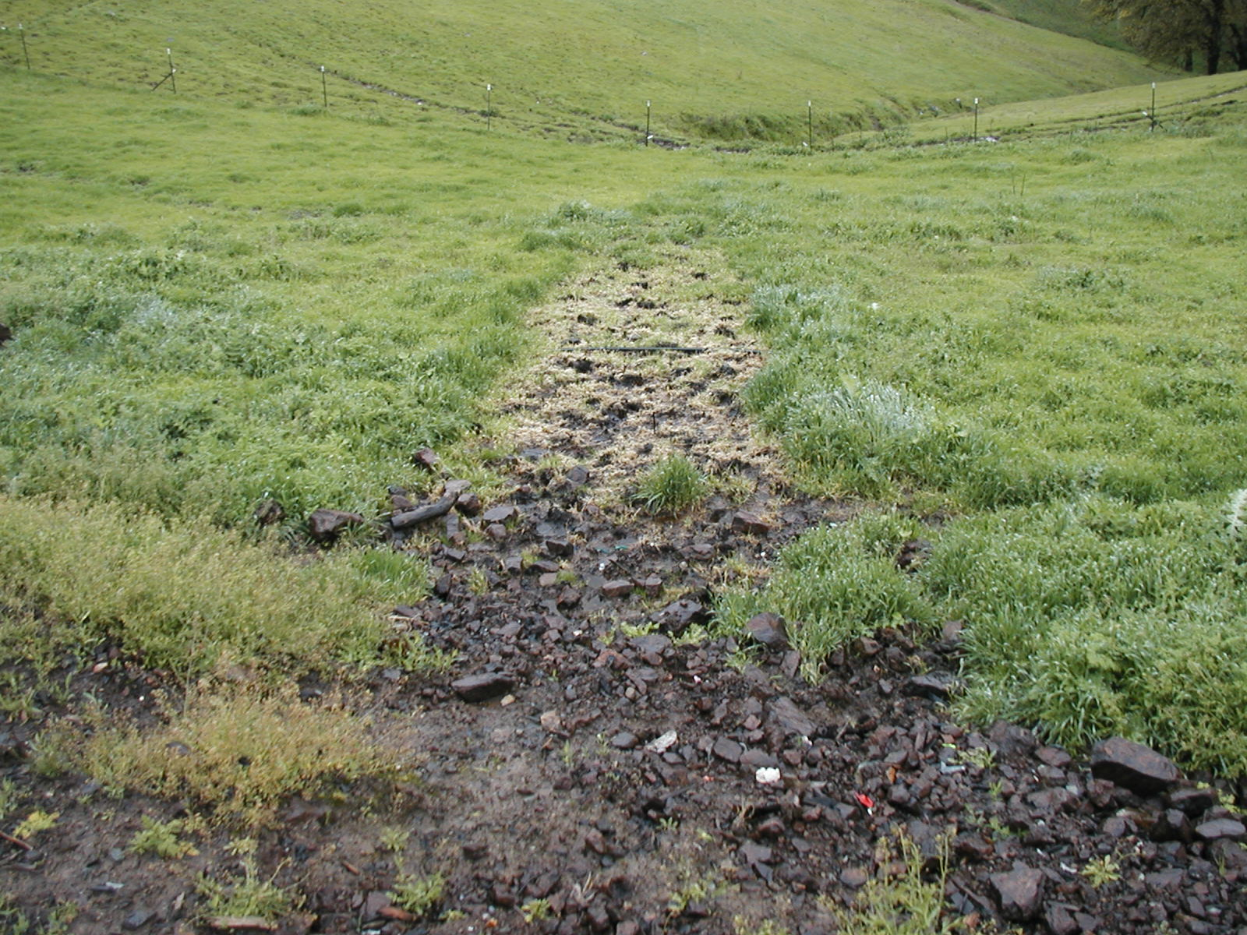
Discharged leachate causing potential surface and ground water impacts

Slide 38
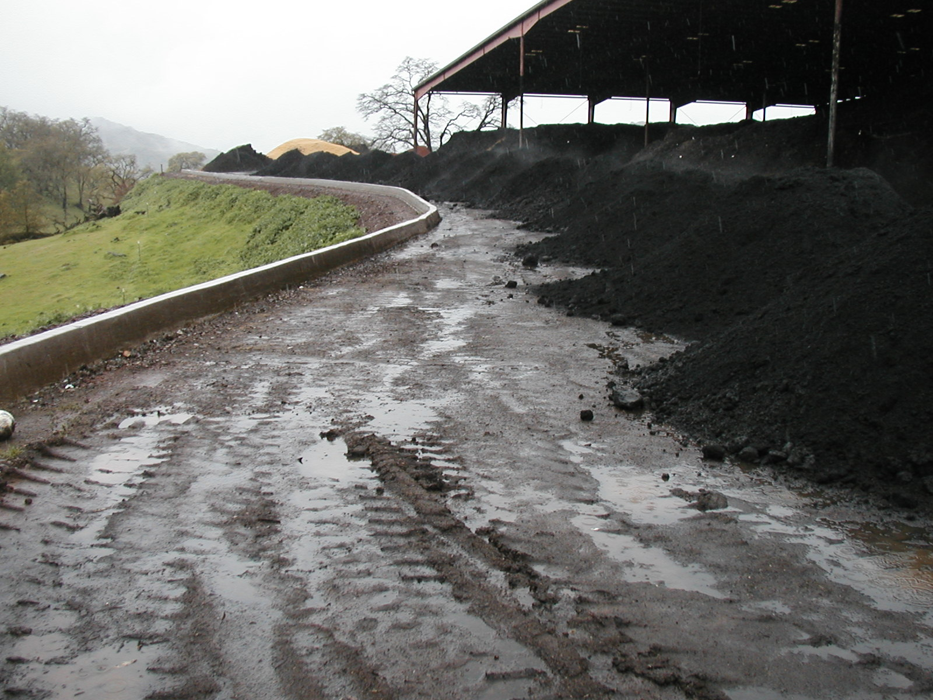
Berm and collection system surrounding composting operations

Slide 39
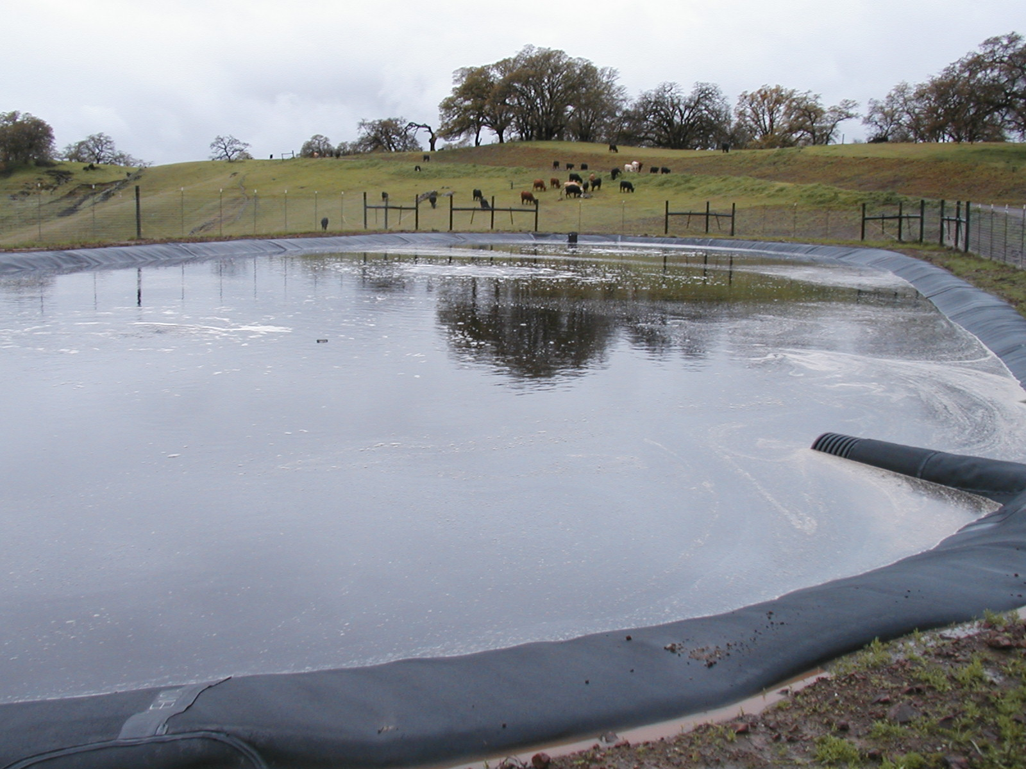
Leachate/storm water collection pond

Slide 40
Challenging Issues

Slide 41
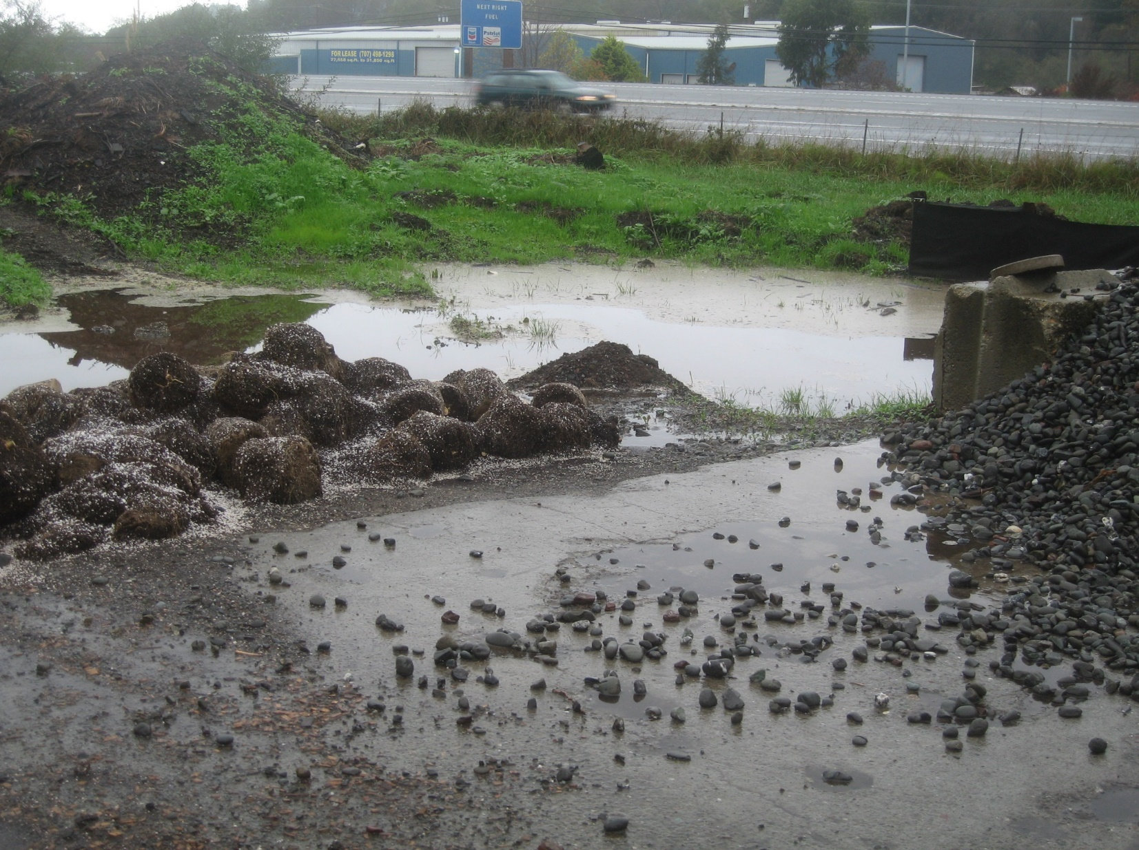
Nutrients and TSS from compost and soil mixing operations

Slide 42
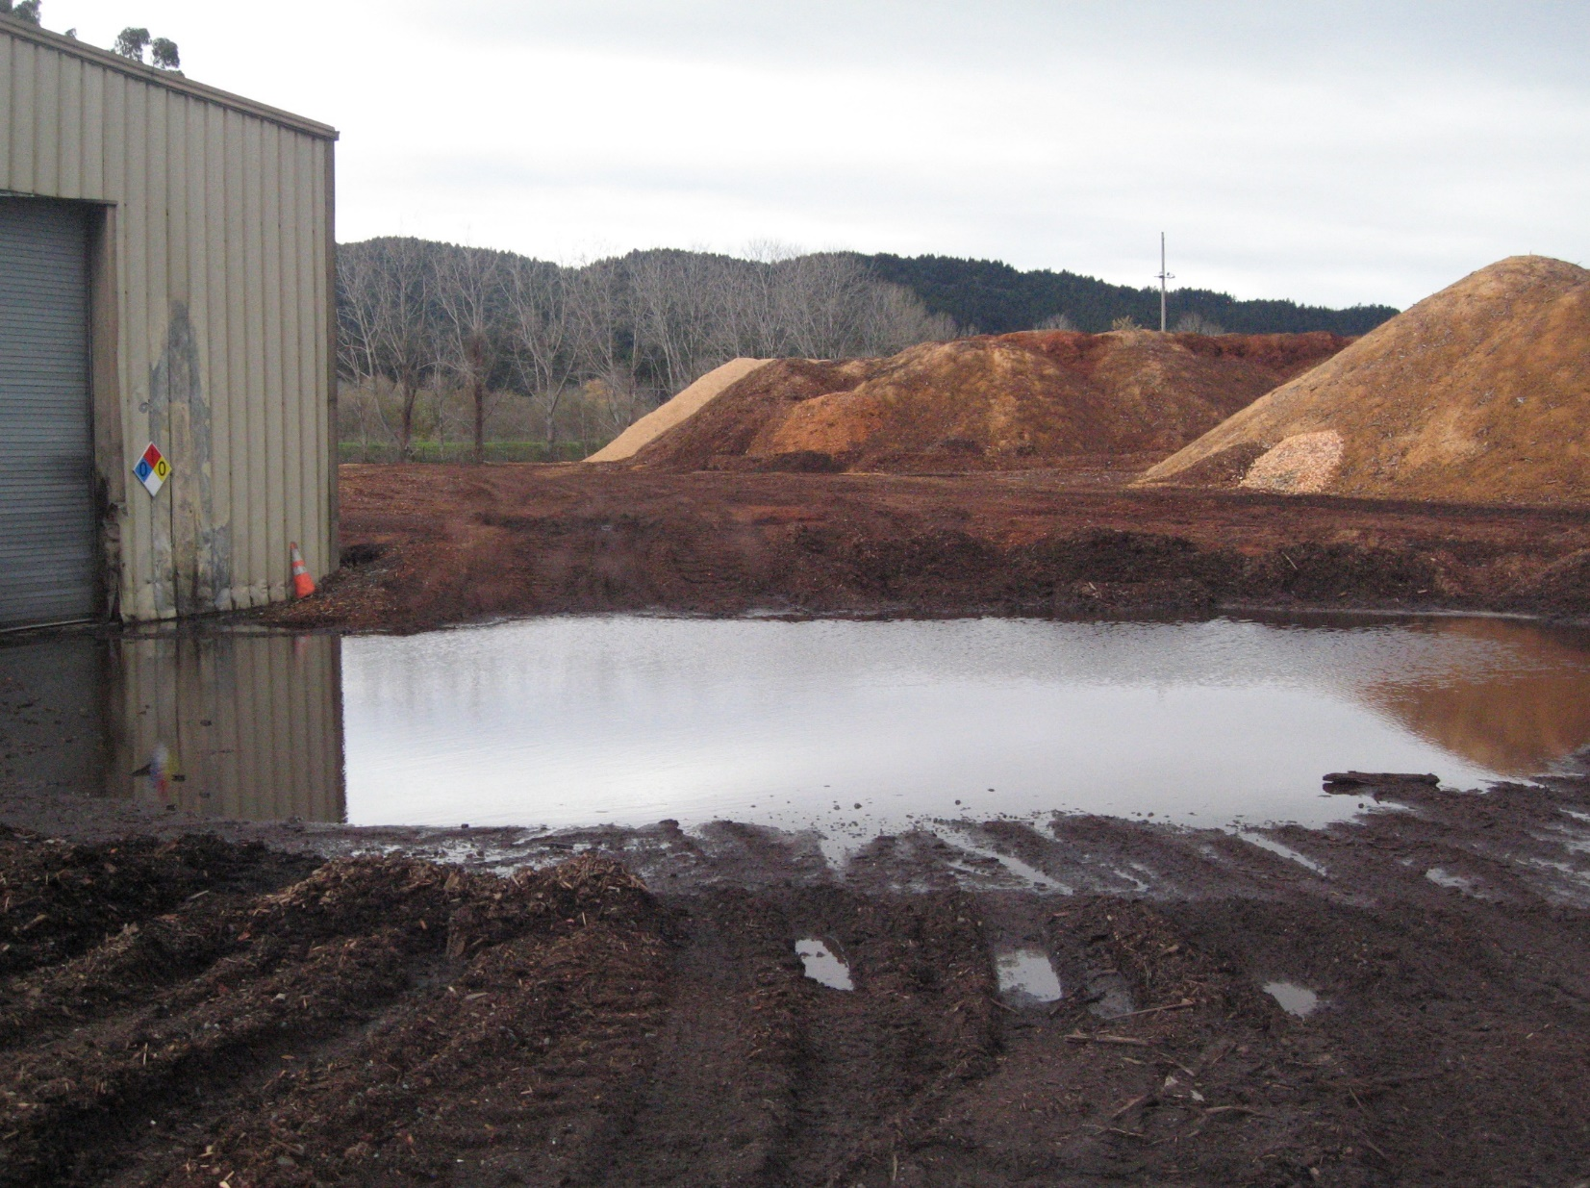
Tannin and lignin from sawdust and wood chip piles and sediment (sawmills, cogeneration plants, soil mixers)

Slide 43
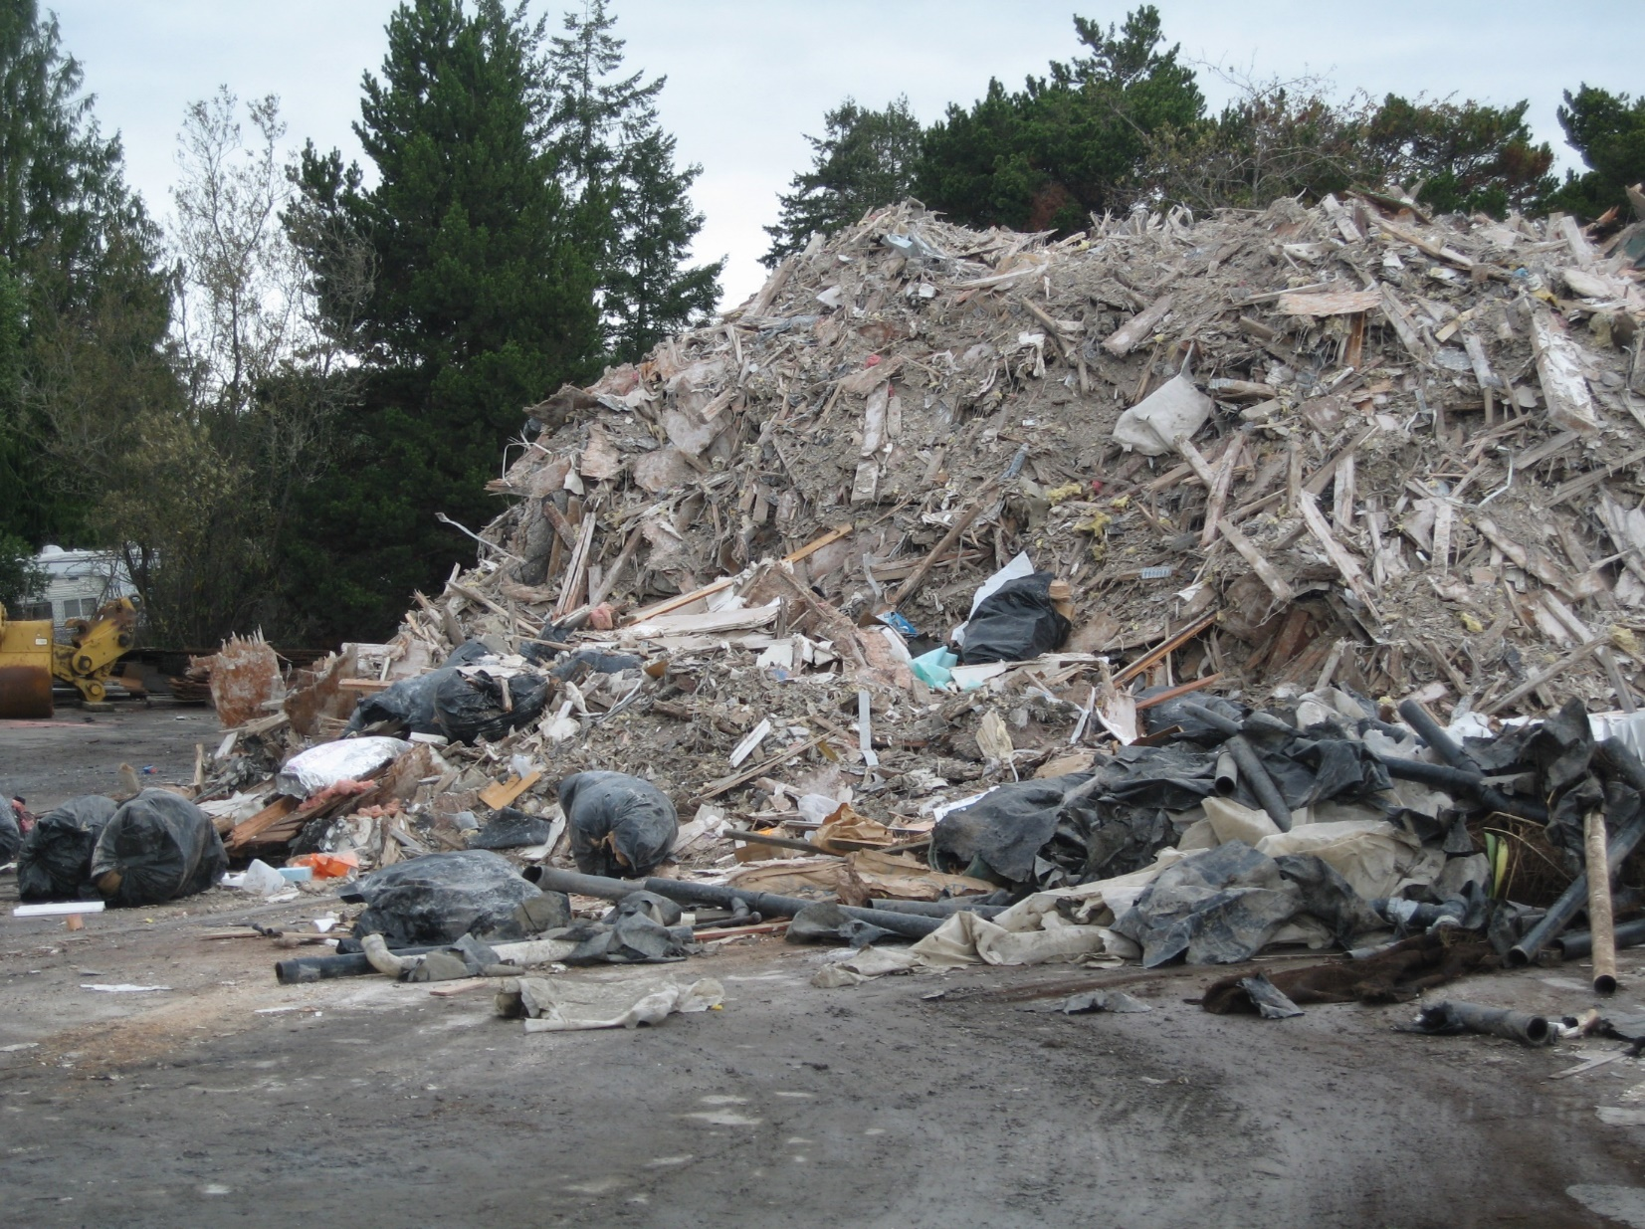
TSS (construction debris yards, trucking company gravel lots)

Slide 44
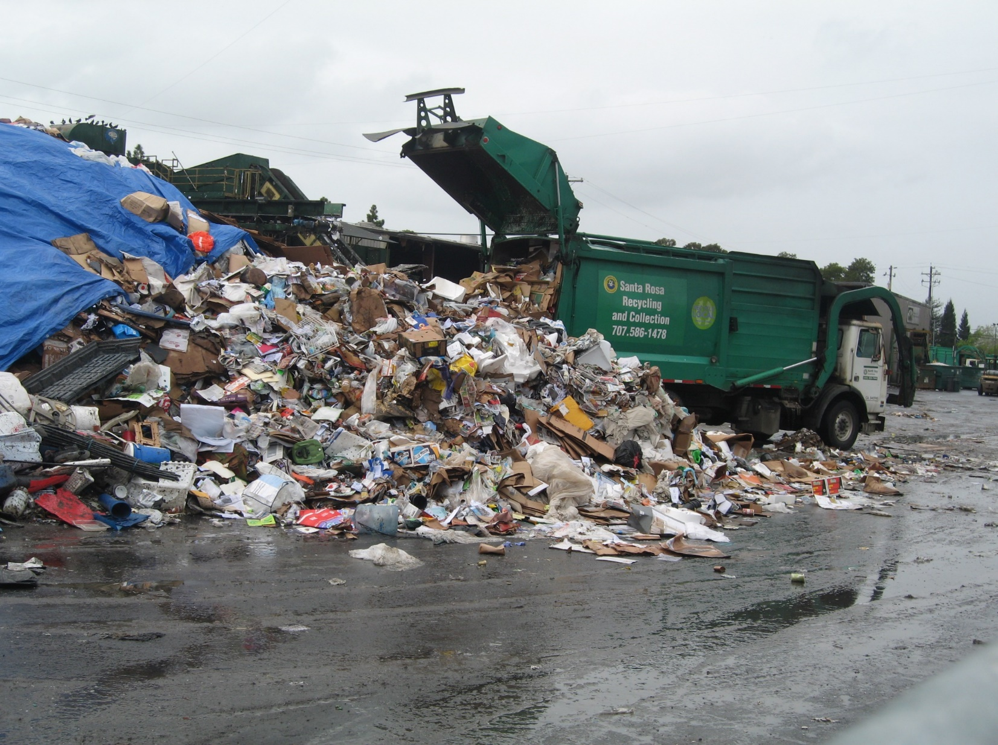
Putrescible waste from uncovered recycling operations – BOD, Nutrients

Slide 45
Compliance Challenges
Dirt! Most NAL exceedances occur from sediment discharges
Lack of or inadequate structural BMPs
Roofing, paved work areas, adequate pond size
Off-site run on
Decreasing number of permittees sampling

Slide 46
Prioritization of Inspections
Facilities that did not sample
Facilities that have an exceedance multiple years in a row
New enrollees
Facilities with NEC or NONA
Non-filers

Slide 47
Current Priorities
Enforcement
Failure to submit reports
Failure to sample
Inadequate BMPs
Non-filers
Enroll soil mixers in IGP

Slide 48
Future Priorities
Enroll mobile industries
Work with sites not subject to storm water program with water quality issues

Slide 49
Thank you!
Questions?

